Slide 1
Fixed Parameter Tractability
One of the ways to cope with hard problems in practice is to realized that problem instances may be associated with some “parameters” related to their complexity.
If the parameter of an instance is small, we might have some hope in finding a polynomial time solution to that instance.
This idea has been investigated in the 1990’s by Downian and Fellowes in their work on fixed parameter tractability.
Definition 1: A parameter is a function from problem instances to the set of natural numbers.
In this way, a parameter is an integer associated with an instance of a problem. Clearly, the input size n is a parameter (although we might not be able to achieve anything new by seeing n in this light).
Other examples include the number of processors in a multi-processor scheduling problem, and the number of distinct item sizes in the bin packing problems.
The value of the optimal solution can also be regarded as a parameter.

Slide 2
Fixed Parameter Tractability
Definition 2: We say that a problem is fixed parameter tractable (FPT) with respect to parameter k if there exists a solution running in f(k)×n ^{O(1)} time, where f is a function of k which is independent of n.

Slide 3
Fixed Parameter Tractability
Pick any two from followings
Hard Problem
Fast (Polynomial time) Algorithms
Exact Solution
Combinations
Hard Problems + Fast Algorithms --------- Approximation Algorithm
Fast Algorithms + Exact Solution ------------ Polynomial Time
Hard Problem + Exact Solution ------------- Fixed Parameter Tractability
(To sacrifice how fast things are, to be somewhere in between polynomial and exponential. This is an area called FTP)

Slide 4
Fixed Parameter Tractability
What is parameter business?
Idea: Aim for exact algorithm, but confine exponential dependence to a parameter.
We use parameter all the times.
For examples:
On a graph there’s two typical parameters. The number of vertices and the number of edges.
If you’re sorting an array. The usual parameter you think about is the size of array.
A parameter, in general, is just some kind of size or complexity. We’re going to call it k of x-
Parameter = k(x), Nonnegative integer, where x is input.
In vertex cover, you are given a graph, we’re going to define some function of that graph.
Just some measure of how tough your problem is. And what we would like is running time that is exponential in k, but polynomial in everything else. Polynomial in the size of the problem.

Slide 5
Fixed Parameter Tractability
What is parameter business?
Goal: Polynomial in problem size n, exponential in parameter k
If you want to achieve this, FPT, What you get is an exact algorithm for your problem that runs really fast provided k is small.
You know the problem is NP-hard in general, but as long as this measure k is reasonably small. I’m able to solve it really fast.
If you can define a parameter, and you know the that in your practical scenarios that parameter will be small, then you’re golden.
Then you can actually solve the problem in a reasonable amount of time and get an exact solution. No approximation here.
Parameterized Problem = Problem + Parameter
Problem w.r.t parameter k
In general, for a single problem there may be several natural parameters. Usually there’s actually one obvious parameter.

Slide 6
Fixed Parameter Tractability
k- Vertex Cover (k means Parameterized Problem)
[Vertex cover is a set of vertices that cover all the edges ]
Given: graph G(V,E)
nonnegative integer k
Decision version of a vertex cover………….
Question: Is there a vertex cover of size k ---say less than or equal to k —is there a vertex cover?
Is there a vertex cover S ≤ V
size of |S| ≤ k ?
And we want the size of S to be less than or equal to k. So, every for every edge, we need to choose one of the two end points.
We want the total number of chosen vertices to be, at most, k.
And so that’s a regular decision problem.

Slide 7
Fixed Parameter Tractability
k- Vertex Cover (k means Parameterized Problem)
Given: graph G(V,E)
nonnegative integer k
Decision version of a vertex cover………….
Question: Is there a vertex cover of size k---say less than or equal to k—is there a vertex cover?
Is there a vertex cover S≤V
of size |S| ≤ k?
But for a parameterized problem, we also to define a parameter function. And that parameter function – guess what? k.
Parameter: k
Most problem, a lot of problems, especially decision versions of optimization problems-
We are minimizing the vertex cover-
We want to decide whether there’s one of size of most k.

Slide 8
Fixed Parameter Tractability
k- Vertex Cover (k means Parameterized Problem)
I guess the first note is that k can actually be small
You have the vertices but what’s the smallest vertices cover?
Answer: 1
Everyone’s holding up one finger. You choose the center as VC.
So it can be that k is much smaller than V, and our goal here is we’re going to get some polynomial dependence in the size of the graph, but we’re going to get an exponential dependence on k.
Let’s start with – what would be the really obvious
brute force solution to vertex cover?
Fig: Star graph

Slide 9
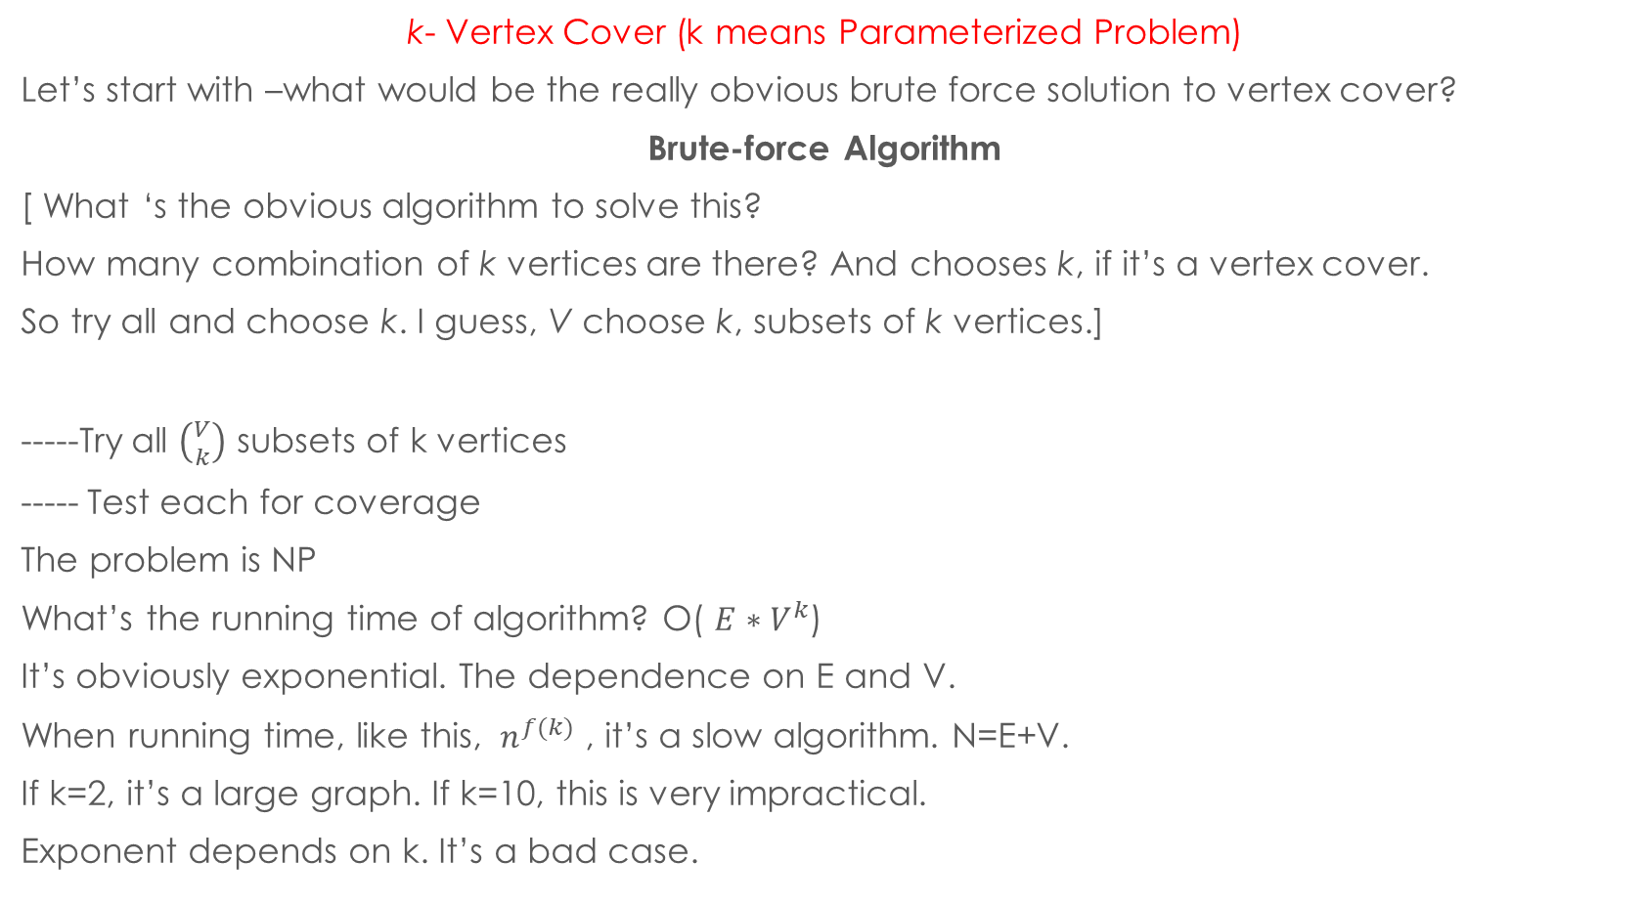
Fixed Parameter Tractability
k- Vertex Cover (k means Parameterized Problem)
Let’s start with –what would be the really obvious brute force solution to vertex cover?
Brute-force Algorithm
[ What ‘s the obvious algorithm to solve this?
How many combination of k vertices are there? And chooses k, if it’s a vertex cover.
So try all and choose k. I guess, V choose k, subsets of k vertices.]
-----Try all $\left({V \atop k}\right)$ subsets of k vertices
----- Test each for coverage
The problem is NP
What’s the running time of algorithm? Ο( ${E∗V}^{k}$)
It’s obviously exponential. The dependence on E and V.
When running time, like this, ${ n}^{f(k)}$ , it’s a slow algorithm. N=E+V.
If k=2, it’s a large graph. If k=10, this is very impractical.
Exponent depends on k. It’s a bad case.
Fig: Star graph

Slide 10
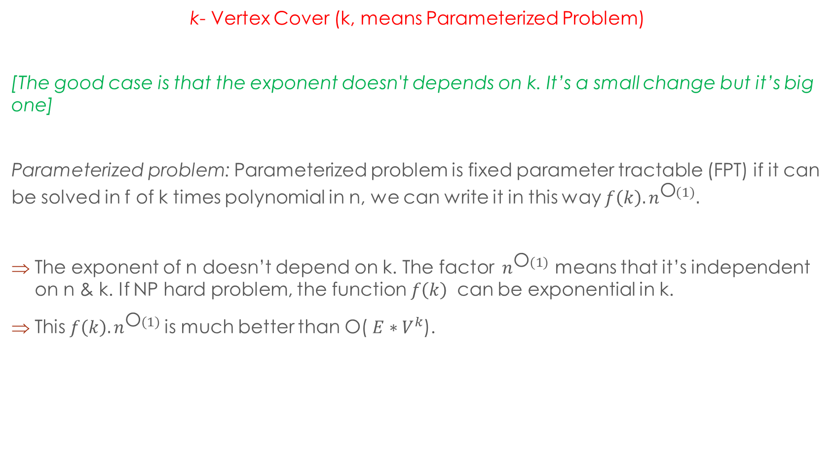
Fixed Parameter Tractability
k- Vertex Cover (k, means Parameterized Problem)
[The good case is that the exponent doesn't depends on k. It’s a small change but it’s big one]
Parameterized problem: Parameterized problem is fixed parameter tractable (FPT) if it can be solved in f of k times polynomial in n, we can write it in this way ${f\left(k\right). n}^{\text{Ο}(1)}.$
The exponent of n doesn’t depend on k. The factor ${ n}^{\text{Ο}(1)}$ means that it’s independent on n & k. If NP hard problem, the function $f\left(k\right)$ can be exponential in k.
This ${f\left(k\right). n}^{\text{Ο}(1)}$is much better than Ο( ${E∗V}^{k}$).
Fig: Star graph

Slide 11
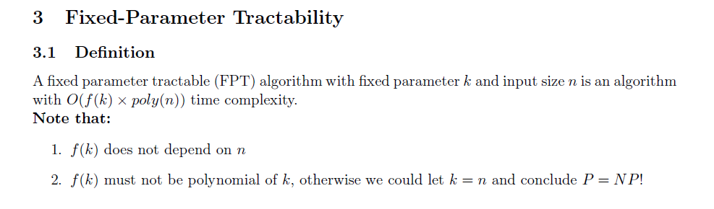
Fixed Parameter Tractability
k- Vertex Cover (k, means Parameterized Problem)
[The good case is that the exponent doesn't depends on k. It’s a small change but it’s big one]

Slide 12
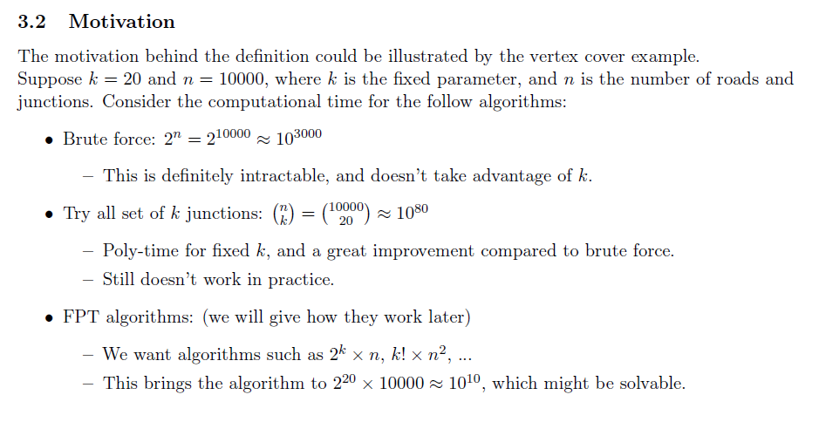
Fixed Parameter Tractability
k- Vertex Cover (k, means Parameterized Problem)
[The good case is that the exponent doesn't depends on k. It’s a small change but it’s big one]

Slide 13
Fixed Parameter Tractability
Bounded-search Tree algorithm
The bounded search tree method attempts to do an exhaustive search on the problem space. However, it uses the parameter to cut of branches of the search tree so that the running time is still polynomial in n.
We illustrate the method by showing that the vertex cover problem is fixed parameter tractable with respect to the size of the optimal cover.
Main idea
• Pick one edge.
• One of its endpoint must be covered.
• Try both and do the recursion.

Slide 14
Fixed Parameter Tractability
k- Vertex Cover (k, means Parameterized Problem)
Bounded-search Tree algorithm
----- Consider any edge e = (u,v)
----- Either u  S or u  S (or both)
----- Guess
(1) u  S: delete u & incident edges
decrement k
recurse on G’ and K’
(2) v  S: delete v & incident edges
decrement k
recurse on G’’ and K’’
u
v
Fig: Star graph

Slide 15
Fixed Parameter Tractability
Bounded-search Tree algorithm
Running Time computation: Draw a recursion tree. This is a divide-and-conquer algorithm in a very weak sense. We start up here with a problem of size n and a parameter k.
Base case: k=0, return whether |E|=0. It’s vertex cover, cover all of the edges.
n, k
n-1, k-1
K
n-1, k-1
n-2, k-2
n-2, k-2
n-2, k-2
n-2, k-2
n-3, k-3
n-3, k-3
n-3, k-3
n-3, k-3
n-3, k-3
n-3, k-3
n-3, k-3
n-3, k-3
K=0

Slide 16

Fixed Parameter Tractability
Bounded-search Tree algorithm
Running Time computation: starting with k and ending with k=0, So the depth of the tree is k. The number of nodes $2^{k}$ , running time Ο( ${V∗2}^{k}$).
Base case: k=0, return whether |E|=0. It’s vertex cover, cover all of the edges.
n, k
n-1, k-1
K
n-1, k-1
n-2, k-2
n-2, k-2
n-2, k-2
n-2, k-2
n-3, k-3
n-3, k-3
n-3, k-3
n-3, k-3
n-3, k-3
n-3, k-3
n-3, k-3
n-3, k-3
K=0

Slide 17
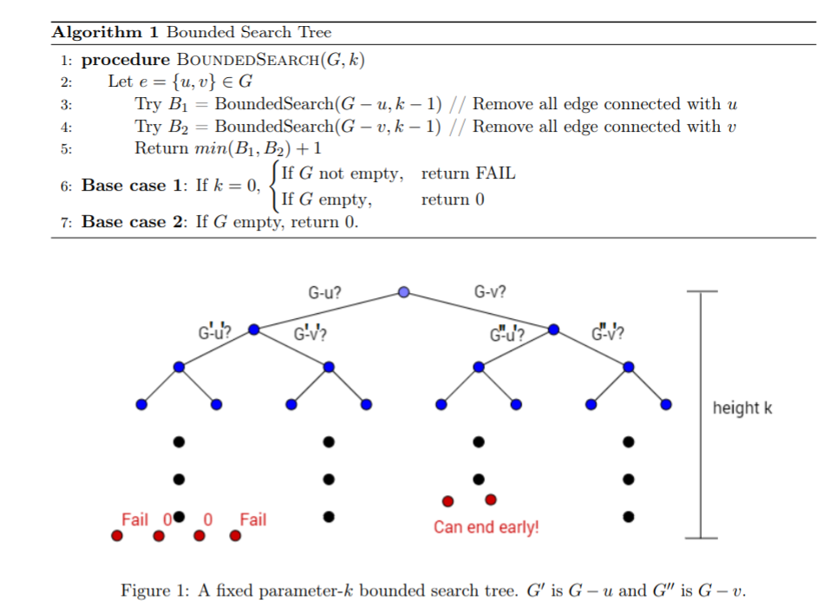
Fixed Parameter Tractability
Bounded-search Tree algorithm

Slide 18
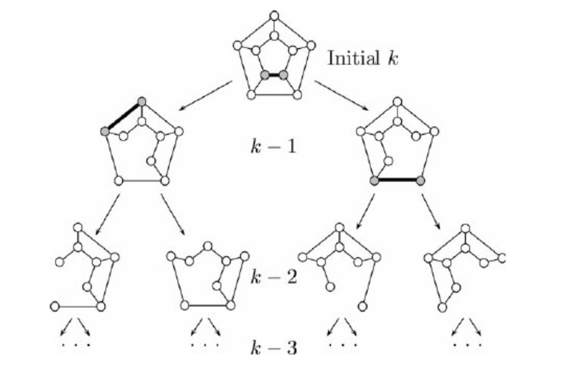
Fixed Parameter Tractability
Bounded-search Tree algorithm

Slide 19
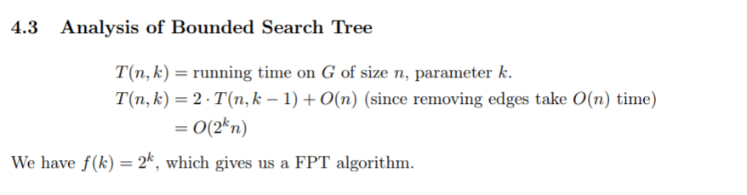
Fixed Parameter Tractability
Bounded-search Tree algorithm

Slide 20
Fixed Parameter Tractability
Kernelization:
A kernelization is a technique for designing efficient algorithms that achieve their efficiency by a preprocessing stage in which inputs to the algorithm are replaced by a smaller input, called a "kernel".
Kernelization is often achieved by applying a set of reduction rules that cut away parts of the instance that are easy to handle.
In parameterized complexity theory, it is often possible to prove that a kernel with guaranteed bounds on the size of a kernel (as a function of some parameter associated to the problem) can be found in polynomial time.
When this is possible, it results in a fixed-parameter tractable algorithm whose running time is the sum of the (polynomial time) kernelization step and the (non-polynomial but bounded by the parameter) time to solve the kernel.
Indeed, every problem that can be solved by a fixed-parameter tractable algorithm can be solved by a kernelization algorithm of this type.

Slide 21
Fixed Parameter Tractability
Kernelization:
A kernel is a problem instance whose solution can be easily (i.e. in polynomial time) extended to a solution to the original problem.
The kernel of a problem instance is its “hard” part. By identifying the kernel of a problem instance, we get a smaller problem, and if the size of the kernel is small, we can hope to solve the problem much faster.
As an example, consider the vertex cover problem with parameter k, the size of the smallest vertex cover. Observe that every vertex with degree more than k has to be in the cover.
Then all of its neighbors must be in the cover to cover its incident edges, and this makes the size of the cover greater than k.
So, we can add such vertices to the cover, remove their incident edges, and try to find an optimal vertex cover in the remaining graph.
This remaining graph is the kernel of the problem because its smallest vertex cover, with the set of vertices with degree more than k in the original graph, gives an optimal solution to the original problem.

Slide 22
Fixed Parameter Tractability
Kernelization: It’s a polynomial-time algorithm converting input (x,k) into equivalent small input (x’,k’). Where answer (x,k) = answer (x’,k’).
Small means |x’| = n’ ≤ f(k)
So, we started with probably a giant problem, x excise n, and we have a parameter k, which we presume is relatively small.
And we convert it into a new input x prime that’s very small. Its size is a function of k. No more dependence on n. n has disappeared from the problem.
We start with something a size n. We produced something the size as function of k. And then ---OK---there’s some other parameter k prime-----doesn’t matter much what it is. It’s going to also be a function of k.
So we started with something of size n. We produced something of size k. In polynomial time.
Because we start with giant problem small k, and we kernelize it down---- so here’s the

Slide 23
Fixed Parameter Tractability
Kernelization: It’s a polynomial-time algorithm converting input (x,k) into equivalent small input (x’,k’). Where answer (x,k) = answer (x’,k’).
Small means |x’| = n’ ≤ f(k)
Because we start with giant problem small k, and we kernelize it down---- so here’s the
Kernel
But somehow, magically, this kernelization procedure produces a new problem that’s only a little bit bigger than k.
So we take the big problem, we make it down to this small thing.
You can run any algorithm you want, any finite algorithm applied to this instance will run in some function of k time.
n
n
k
k

Slide 24
Fixed Parameter Tractability

Slide 25
Fixed Parameter Tractability

